Slide 1


Lightweight Authentication System with Facial Recognition
Degree in Computer Engineering
N.º 29059– Diogo Rocha Azevedo;
N.º 29086– Letícia Cruz Loureiro.
Supervisor(s):
Engineer Abel Dantas;
Professor Doctor Jorge Ribeiro.
Degree in Computer Engineering| Escola Superior de Tecnologia e Gestão| Course: Projeto IV | Academic Year: 2024/2025

Slide 2


■ Index
Degree IN Computer engineering
Introduction
Research
Material Lifting
Workplan/ Planning
Risks and Mitigations
Hardware Assembly and OS Configuration
Database Architecture Overview - FaceAuth System
FaceAuth - System Architecture Overview
Conclusion
Web References
@Diogo Azevedo, Letícia Loureiro| Course: Projeto IV – Academic Year 2024/2025 – Lightweight Authentication System with Facial Recognition
- 2 -

Slide 3
■ 1. Introduction
Degree IN Informatics engineering
Project Objective:
Development of an efficient and secure authentication system using facial recognition.
Initial Phase – Research and Investigation:
We consulted videos and documentation to understand the processes required for implementing the system.
We identified the essential procedures and components for development.
Material Selection:
Based on our research, we carefully selected the necessary materials for the system.
Work Plan Organization:
We created a detailed work plan with steps organized chronologically.
The plan covers everything from the initial assembly of the system to the implementation of facial recognition and the creation of interaction interfaces.
@Diogo Azevedo, Letícia Loureiro| Course: Projeto IV – Academic Year 2024/2025 – Lightweight Authentication System with Facial Recognition
- 3 -

Slide 4
■ 1. Introduction
Degree IN Informatics engineering
FaceAuth Solution:
FaceAuth is an innovative solution that combines accessible technology with advanced authentication strategies.
The goal is to provide a secure, intuitive, and user-friendly authentication method.
@Diogo Azevedo, Letícia Loureiro| Course: Projeto IV – Academic Year 2024/2025 – Lightweight Authentication System with Facial Recognition
- 4 -

Slide 5
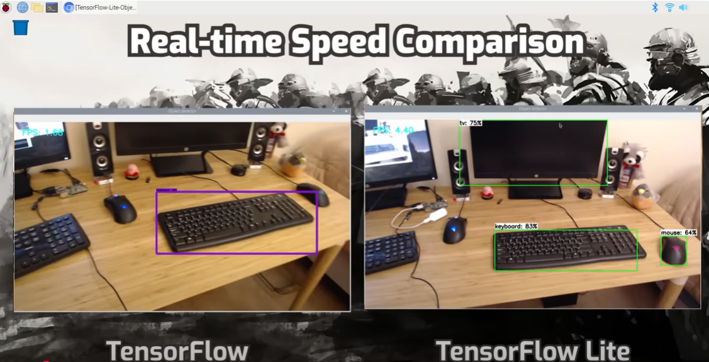
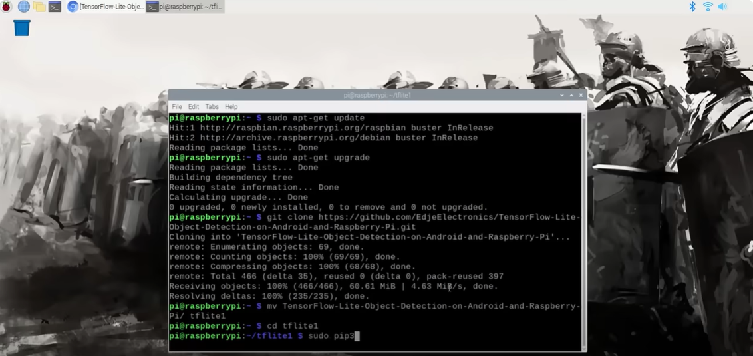
■ 2. Research
Degree IN Informatics engineering
Initial Research:
We watched several videos and consulted documentation to understand the entire essential process, such as installing the Raspberry Pi OS, configuring via SSH, and integrating peripherals.
Documentation and Guides:
We analyzed tutorials and official guides that demonstrated, for example, the connection of cameras and displays, helping define the technical steps.
@Diogo Azevedo, Letícia Loureiro| Course: Projeto IV – Academic Year 2024/2025 – Lightweight Authentication System with Facial Recognition
- 5 -

Slide 6
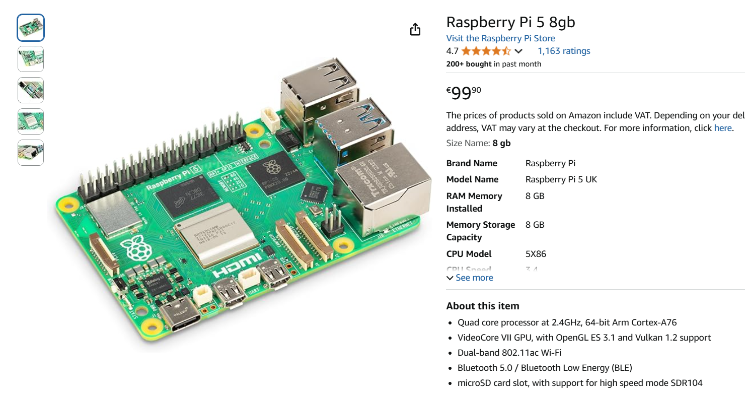
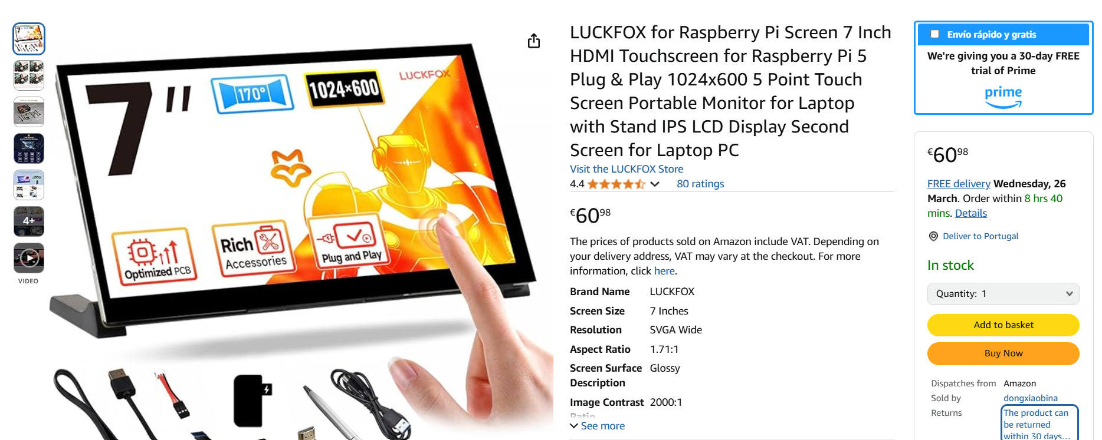
■ 3. Material Lifting
Degree IN Informatics engineering
Component Identification:
Based on our research, we prepared a detailed document, as shown in the photo, listing the essential materials, such as:
Raspberry Pi 5;
Official camera;
HDMI touchscreen display;
Power supply, among others; We included specifications, prices, and purchase links.
@Diogo Azevedo, Letícia Loureiro| Course: Projeto IV – Academic Year 2024/2025 – Lightweight Authentication System with Facial Recognition
- 6 -

Slide 7
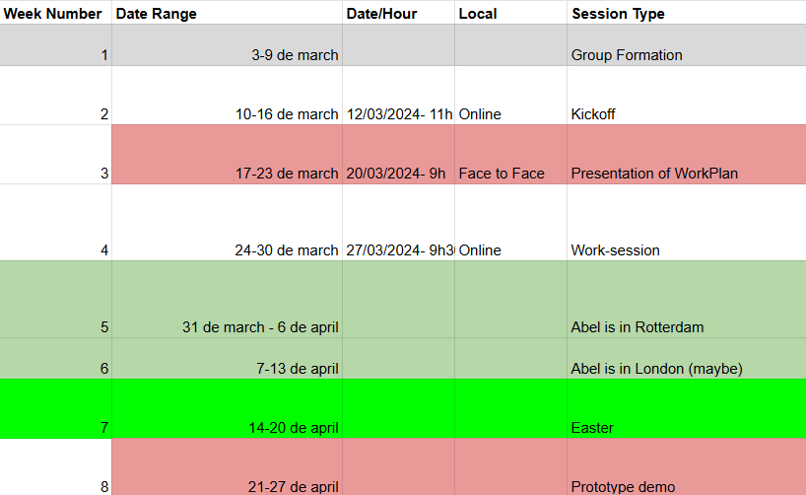
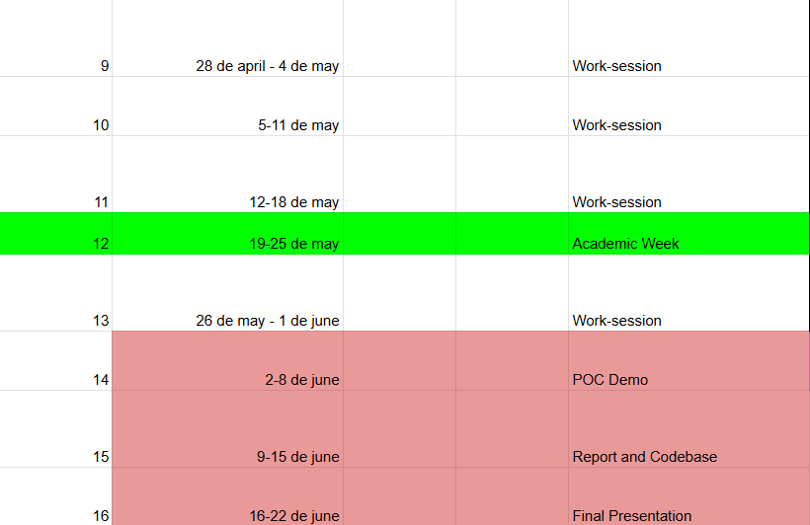
■ 4. Workplan/ Planning
Degree IN Informatics engineering
This table shows our workplan, organizing the activities, objectives, and deliverables for each week, providing a clear overview of the entire project development.
@Diogo Azevedo, Letícia Loureiro| Course: Projeto IV – Academic Year 2024/2025 – Lightweight Authentication System with Facial Recognition
- 7 -

Slide 8
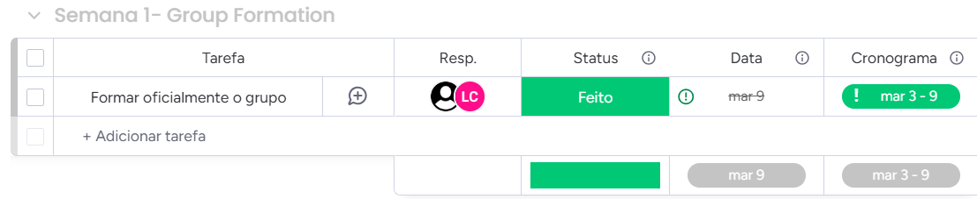
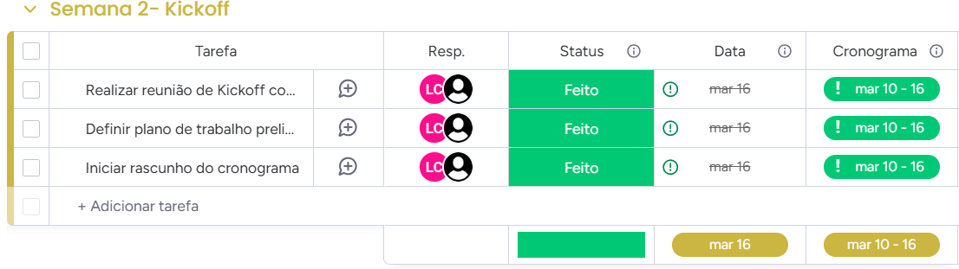
■ 4. Workplan/ Planning
Degree IN Informatics engineering
Week 1 (3-9 march) - Group Formation
Objectives:
Officially form the group.
Week 2 (10-16 march) - Kickoff
Objectives:
Hold a kickoff meeting with the supervisor to validate the objective and initial requirements and give a brief presentation.
Define a preliminary work plan.
Start drafting the schedule.
@Diogo Azevedo, Letícia Loureiro| Course: Projeto IV – Academic Year 2024/2025 – Lightweight Authentication System with Facial Recognition
- 8 -

Slide 9
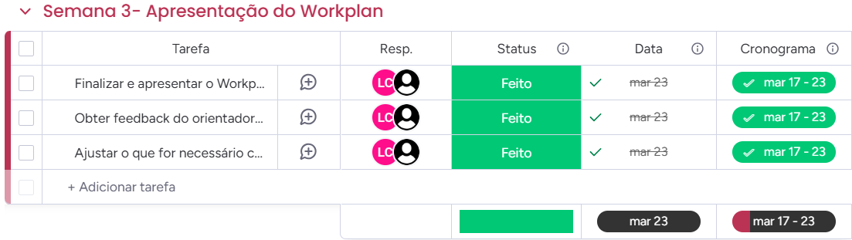
■ 4. Workplan/ Planning
Degree IN Informatics engineering
Week 3 (17-23 march) - Workplan Presentation
Objectives:
Finalize and present the workplan: timeline, milestones, expected deliverables, and working methodology.
Obtain feedback from the supervisor on the plan.
Make any necessary adjustments based on the feedback.
Deliverable:
Make any necessary adjustments based on the feedback.
@Diogo Azevedo, Letícia Loureiro| Course: Projeto IV – Academic Year 2024/2025 – Lightweight Authentication System with Facial Recognition
- 9 -

Slide 10
■ 4. Workplan/ Planning
Degree IN Informatics engineering
Week 4 (24-30 march) - Work-session
Objectives:
Deepen research on facial recognition technologies (TensorFlow Lite, OpenCV, TinyML, etc.) and integration with Raspberry Pi.
Define the system architecture (how each component communicates: hardware, API, dashboard).
Plan the database and dashboard structure..
Assemble all hardware components and install the necessary drivers and Raspberry Pi OS.
Deliverables:
Architecture document/diagram.
Conceptual prototype of how facial capture and identification will be performed.
@Diogo Azevedo, Letícia Loureiro| Course: Projeto IV – Academic Year 2024/2025 – Lightweight Authentication System with Facial Recognition
- 10 -

Slide 11
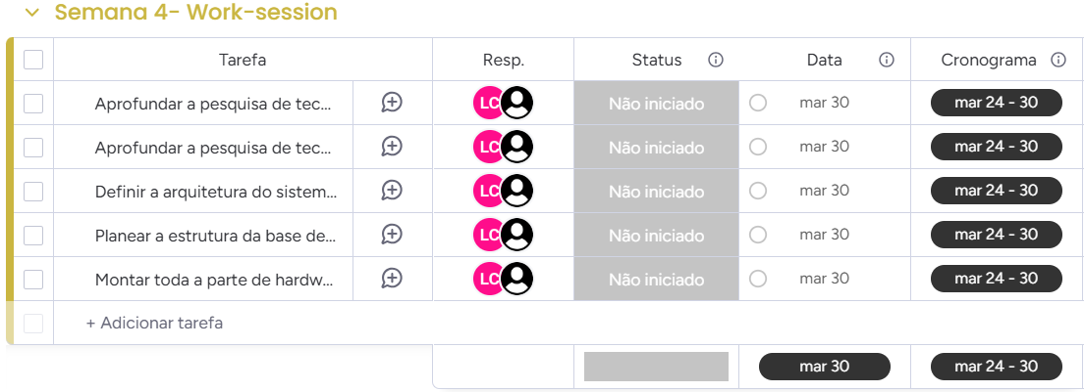
■ 4. Workplan/ Planning
Degree IN Informatics engineering
@Diogo Azevedo, Letícia Loureiro| Course: Projeto IV – Academic Year 2024/2025 – Lightweight Authentication System with Facial Recognition
- 11 -

Slide 12
■ 4. Workplan/ Planning
Degree IN Informatics engineering
Week 5 (31 march - 6 april)
Objectives:
Start implementing the facial recognition module (local prototype on PC or directly on the microcontroller/Raspberry Pi).
Define how user management will be handled (image/face storage, database, etc.).
Prepare for the intermediate delivery on April 9 (report or partial demonstration).
Extra: Add audio feedback (sound for successful recognition; sound for unrecognized users).
Deliverables:
Initial code snippet of the facial recognition module (even if basic).
Paragraph describing the data/face storage strategy.
@Diogo Azevedo, Letícia Loureiro| Course: Projeto IV – Academic Year 2024/2025 – Lightweight Authentication System with Facial Recognition
- 12 -

Slide 13
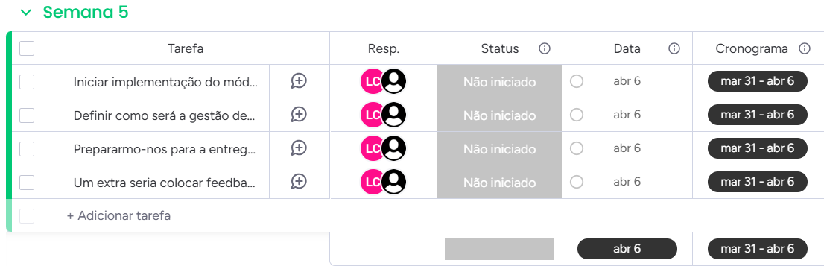
■ 4. Workplan/ Planning
Degree IN Informatics engineering
@Diogo Azevedo, Letícia Loureiro| Course: Projeto IV – Academic Year 2024/2025 – Lightweight Authentication System with Facial Recognition
- 13 -

Slide 14
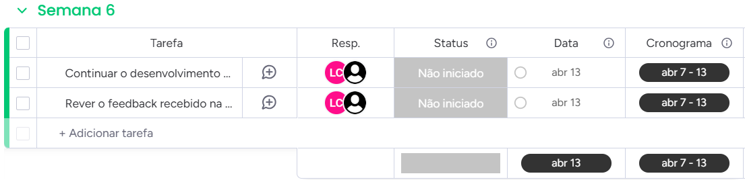
■ 4. Workplan/ Planning
Degree IN Informatics engineering
Week 6 (7-13 april)
Objectives:
Continue developing the facial recognition system by running basic tests with a few images.
Review the feedback received from the intermediate delivery on April 9.
Deliverable:
Short vídeo.
@Diogo Azevedo, Letícia Loureiro| Course: Projeto IV – Academic Year 2024/2025 – Lightweight Authentication System with Facial Recognition
- 14 -

Slide 15
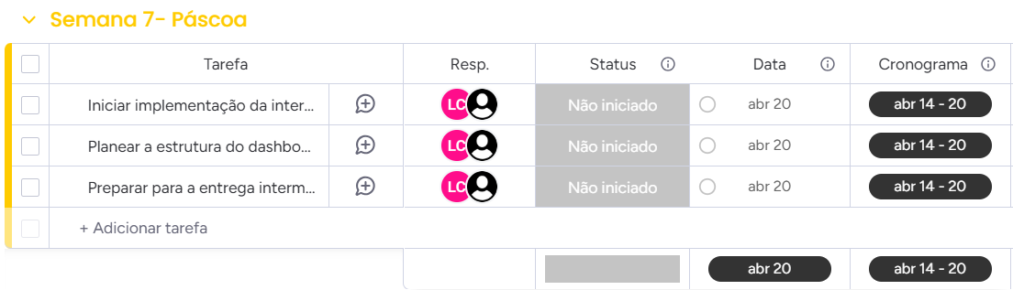
■ 4. Workplan/ Planning
Degree IN Informatics engineering
Week 7 (14-20 de april) - Easter
Objectives:
Begin implementing the touchscreen panel interface (simple UI for the end user).
Plan the structure of the admin dashboard (screen prototypes, configuration flows).
Prepare for the intermediate delivery on April 19 (report/demonstration of progress made).
Deliverables:
Functional prototype of the touchscreen panel (even if still basic).
Mockups or navigable prototype of the admin dashboard.
@Diogo Azevedo, Letícia Loureiro| Course: Projeto IV – Academic Year 2024/2025 – Lightweight Authentication System with Facial Recognition
- 15 -

Slide 16
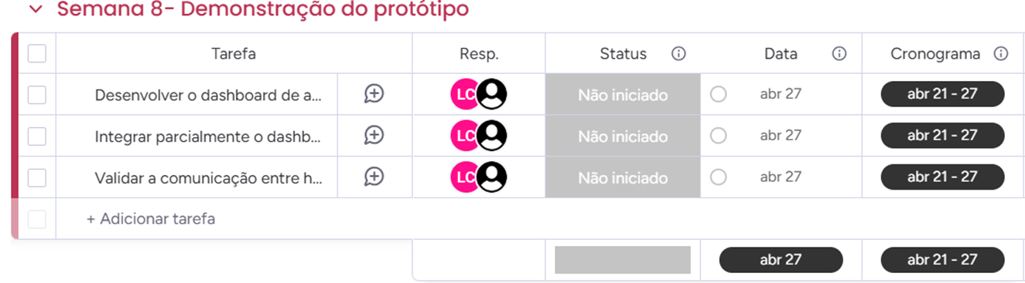
■ 4. Workplan/ Planning
Degree IN Informatics engineering
Week 8 (21-27 de april) - Prototype Demonstration
Objectives:
Validate communication between hardware and software.
Ensure facial recognition is working on the physical setup.
Deliverables:
Initial documentation.
Video showing facial recognition in operation.
@Diogo Azevedo, Letícia Loureiro| Course: Projeto IV – Academic Year 2024/2025 – Lightweight Authentication System with Facial Recognition
- 16 -

Slide 17
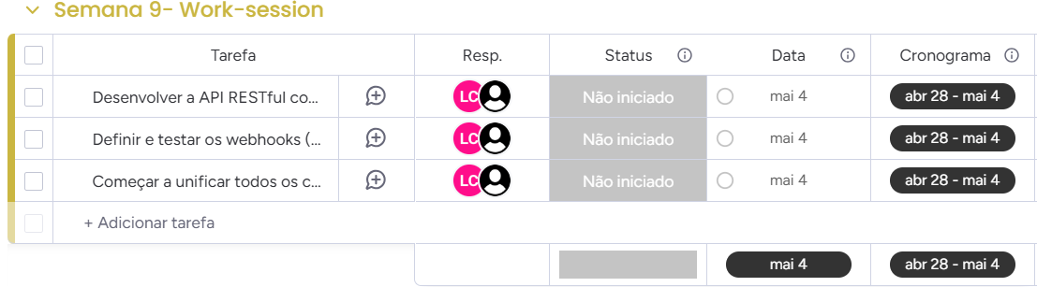
■ 4. Workplan/ Planning
Degree IN Informatics engineering
Week 9 (28 april - 4 may) - Work-session
Objectives:
Develop the RESTful API with documentation using Swagger (or another tool).
Start unifying the components (facial recognition + API).
Implement CRUD operations.
Extra: Define and test webhooks (integrations with Zapier, Discord, etc.).
Deliverables:
API
@Diogo Azevedo, Letícia Loureiro| Course: Projeto IV – Academic Year 2024/2025 – Lightweight Authentication System with Facial Recognition
- 17 -

Slide 18
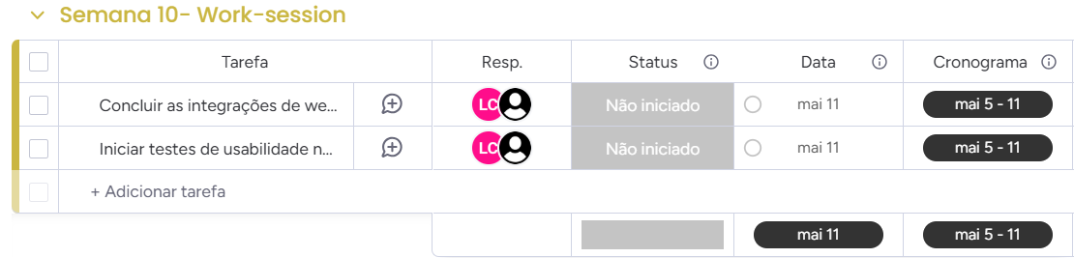
■ 4. Workplan/ Planning
Degree IN Informatics engineering
Week 10 (5-11 may) - Work-session
Objectives:
Complete webhook integrations and refine the dashboard (enable webhook configuration).
Begin usability testing on the touchscreen panel and dashboard (end-to-end).
Deliverables:
Dashboard with webhook management functionality.
Initial usability testing report.
@Diogo Azevedo, Letícia Loureiro| Course: Projeto IV – Academic Year 2024/2025 – Lightweight Authentication System with Facial Recognition
- 18 -

Slide 19
■ 4. Workplan/ Planning
Degree IN Informatics engineering
Week 11 (12-18 may) – Work-session
Objectives:
Conduct more in-depth testing (functional, integration) across all modules.
Fix bugs and optimize the performance of facial recognition (response time).
Extra: Integrate CI/CD to facilitate deployment and automated testing.
Extra: Perform security assessments (vulnerability testing, encryption validation, and protection of sensitive data, reinforcing the system’s authentication purpose).
Deliverables:
List of identified and fixed bugs.
Extra: Configured CI/CD pipeline.
@Diogo Azevedo, Letícia Loureiro| Course: Projeto IV – Academic Year 2024/2025 – Lightweight Authentication System with Facial Recognition
- 19 -

Slide 20
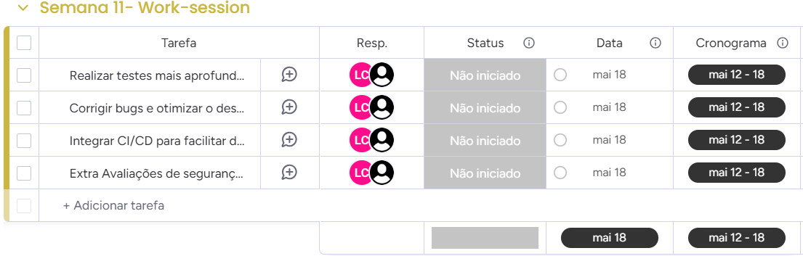
■ 4. Workplan/ Planning
Degree IN Informatics engineering
@Diogo Azevedo, Letícia Loureiro| Course: Projeto IV – Academic Year 2024/2025 – Lightweight Authentication System with Facial Recognition
- 20 -

Slide 21
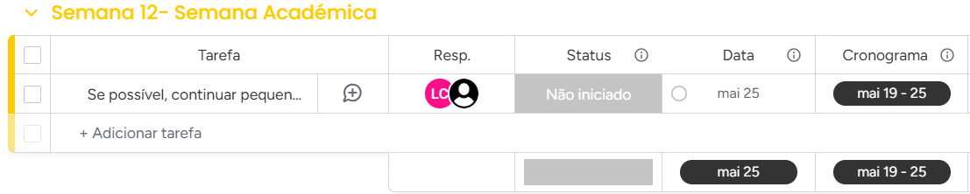
■ 4. Workplan / Planning
Degree IN Informatics engineering
Week 12 (19-25 may) - Academic Week
Objectives:
If possible, continue with minor adjustments or testing.
@Diogo Azevedo, Letícia Loureiro| Course: Projeto IV – Academic Year 2024/2025 – Lightweight Authentication System with Facial Recognition
- 21 -

Slide 22
■ 4. Workplan/ Planning
Degree IN Informatics engineering
Week 13 (26 may - 8 june) – Work-session
Objectives:
Prepare the presentation of the functional Proof of Concept (POC), with facial recognition, dashboard, and integrations working together.
Conduct a general review with the supervisor to gather feedback.
Start preparing for the final presentation and POC demonstration.
Coordinate with the Product Design colleague (Bruna).
Deliverables:
POC demonstration.
Feedback report and plan for corrections/improvements.
@Diogo Azevedo, Letícia Loureiro| Course: Projeto IV – Academic Year 2024/2025 – Lightweight Authentication System with Facial Recognition
- 22 -

Slide 23
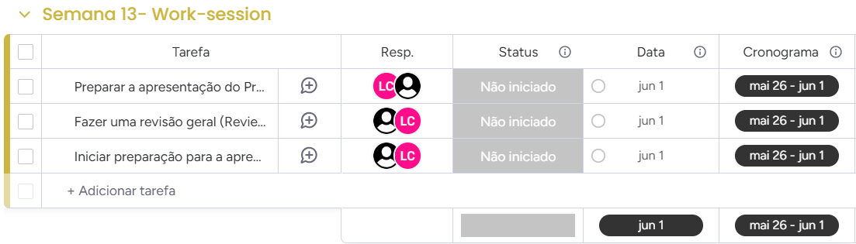
■ 4. Workplan/ Planning
Degree IN Informatics engineering
@Diogo Azevedo, Letícia Loureiro| Course: Projeto IV – Academic Year 2024/2025 – Lightweight Authentication System with Facial Recognition
- 23 -

Slide 24
■ 4. Workplan/ Planning
Degree IN Informatics engineering
Week 14 (2 june - 8 june) - POC Presentation
Objectives:
Present the functional Proof of Concept (POC), with facial recognition, dashboard, and integrations working together.
Conduct a general review with the supervisor to gather feedback.
Begin preparation for the final presentation.
Deliverables:
Full POC presentation.
Feedback report and improvement plan for the final presentation.
@Diogo Azevedo, Letícia Loureiro| Course: Projeto IV – Academic Year 2024/2025 – Lightweight Authentication System with Facial Recognition
- 24 -

Slide 25
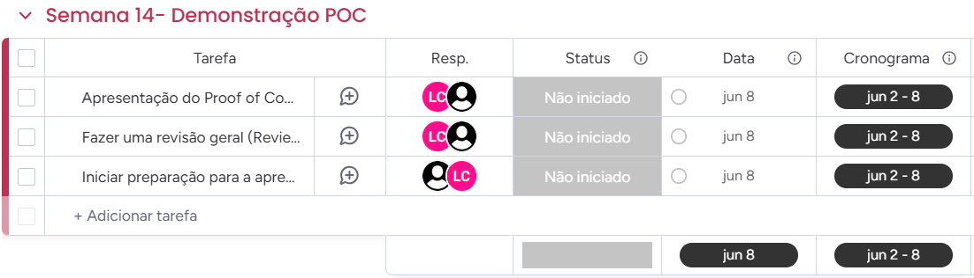
■ 4. Workplan/ Planning
Degree IN Informatics engineering
@Diogo Azevedo, Letícia Loureiro| Course: Projeto IV – Academic Year 2024/2025 – Lightweight Authentication System with Facial Recognition
- 25 -

Slide 26
■ 4. Workplan/ Planning
Degree IN Informatics engineering
Week 15 (9-15 june) - Report and Codebase
Objectives:
Implement corrections and improvements identified during the previous week’s review.
Conduct final robustness and performance tests (stress tests, if applicable).
Finalize project documentation (Installation Manual, User Guide, Swagger API documentation).
Complete the documentation for the final checkpoint.
Deliverables:
Final (or near-final) version of the system, with all modules integrated.
Complete and organized documentation for submission.
@Diogo Azevedo, Letícia Loureiro| Course: Projeto IV – Academic Year 2024/2025 – Lightweight Authentication System with Facial Recognition
- 26 -

Slide 27
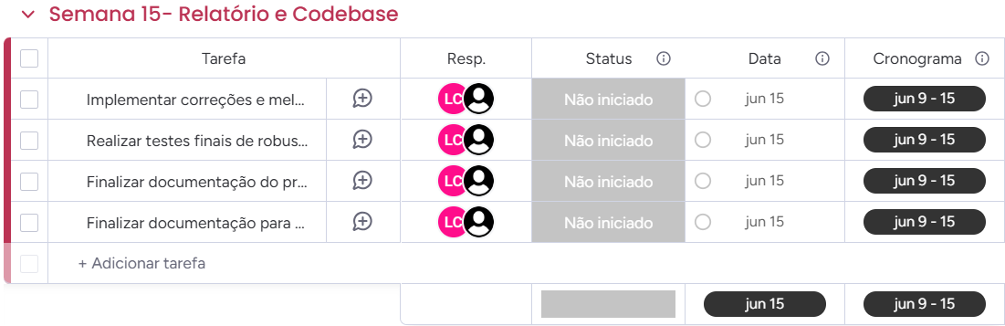
■ 4. Workplan/ Planning
Degree IN Informatics engineering
@Diogo Azevedo, Letícia Loureiro| Course: Projeto IV – Academic Year 2024/2025 – Lightweight Authentication System with Facial Recognition
- 27 -

Slide 28
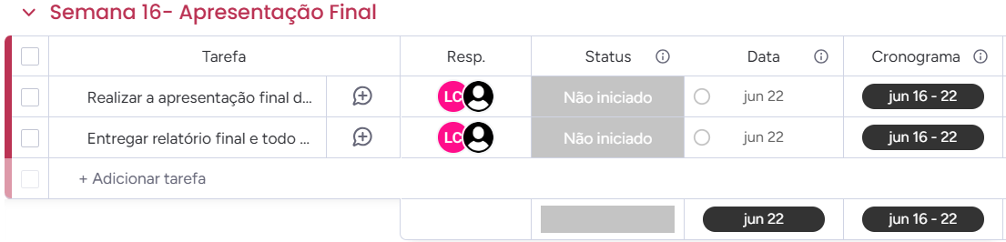
■ 4. Workplan/ Planning
Degree IN Informatics engineering
Week 16 (16-22 june) - Final Presentation
Objectives:
Deliver the final project presentation (live demo, slides with results and conclusions).
Submit the final report and all required materials (code, documentation, etc.).
Deliverables:
Final presentation (slides, demo).
Submission of all project artifacts (repository, documentation, user manual).
@Diogo Azevedo, Letícia Loureiro| Course: Projeto IV – Academic Year 2024/2025 – Lightweight Authentication System with Facial Recognition
- 28 -

Slide 29
■ 5. Risks and Mitigations
Degree IN Informatics engineering
Technical Risk in Facial Recognition
Description: Low accuracy or slow algorithm performance.
Mitigation: Use reliable libraries (e.g., TensorFlow Lite), test early, and fine-tune parameters.
Hardware Integration (Raspberry Pi)
Description: Issues with drivers, camera, or communication between components.
Mitigation: Test from the beginning, follow official documentation, and have a backup plan.
Data Security and Privacy
Description: Facial data leaks or authentication failures.
Mitigation: Use encryption, validate API security, and perform vulnerability testing.
Integration with External Services (Webhooks, Zapier, Discord)
Description: Communication failures or incompatibilities.
Mitigation: Test in a controlled environment and thoroughly document the APIs.
@Diogo Azevedo, Letícia Loureiro| Course: Projeto IV – Academic Year 2024/2025 – Lightweight Authentication System with Facial Recognition
- 29 -

Slide 30
■ 5. Risks and Mitigations
Degree IN Informatics engineering
Schedule Management and Delays
Description: Delays due to technical challenges or coordination issues.
Mitigation: Monitor progress regularly through meetings and adjust the plan as needed.
Lack of Proper Documentation
Description: Makes maintenance and module integration more difficult.
Mitigation: Keep documentation updated, specially design decisions and security integrations.
Sound Feedback (Extra Feature)
Description: May interfere with the main flow and consume time.
Mitigation: Implement incrementally, prioritizing system stability.
Tools and Infrastructure (CI/CD) – Extra
Description: Issues with deployment pipeline setup and continuous integration.
Mitigation: Test early, use reliable tools, and keep configuration backups.
@Diogo Azevedo, Letícia Loureiro| Course: Projeto IV – Academic Year 2024/2025 – Lightweight Authentication System with Facial Recognition
- 30 -

Slide 31
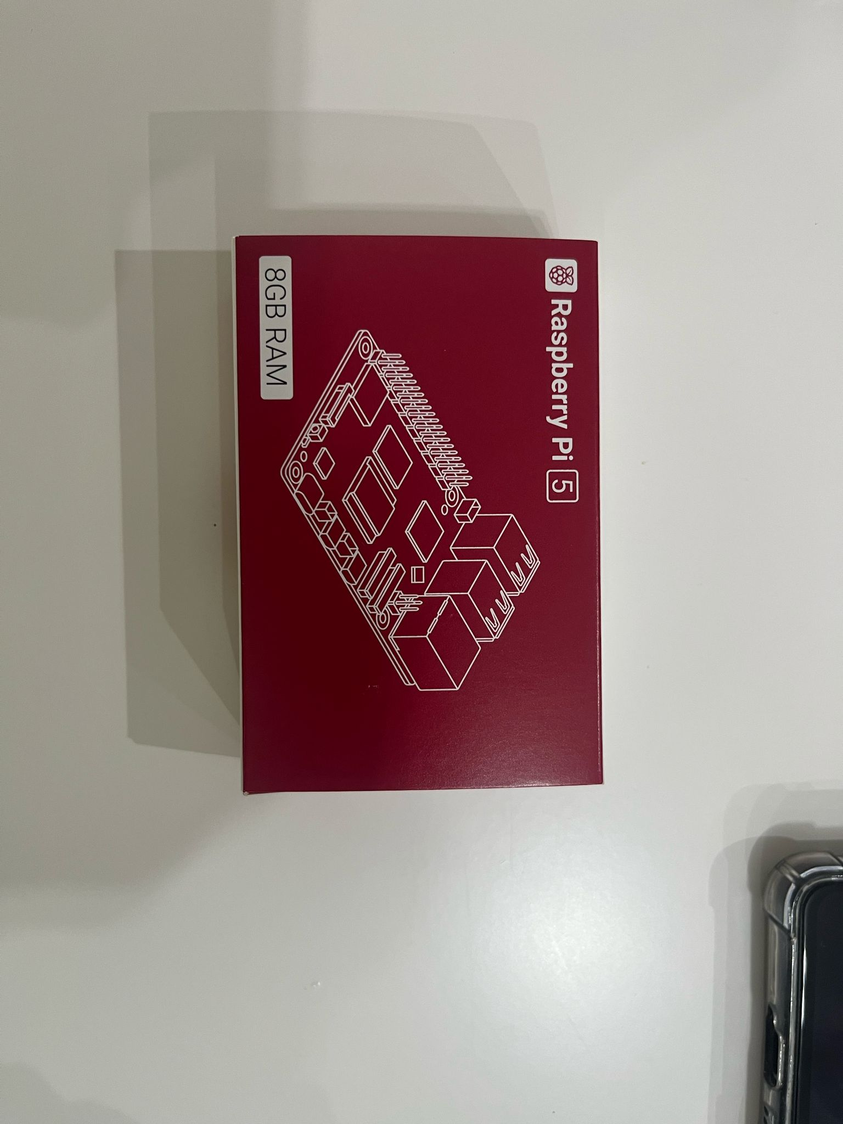
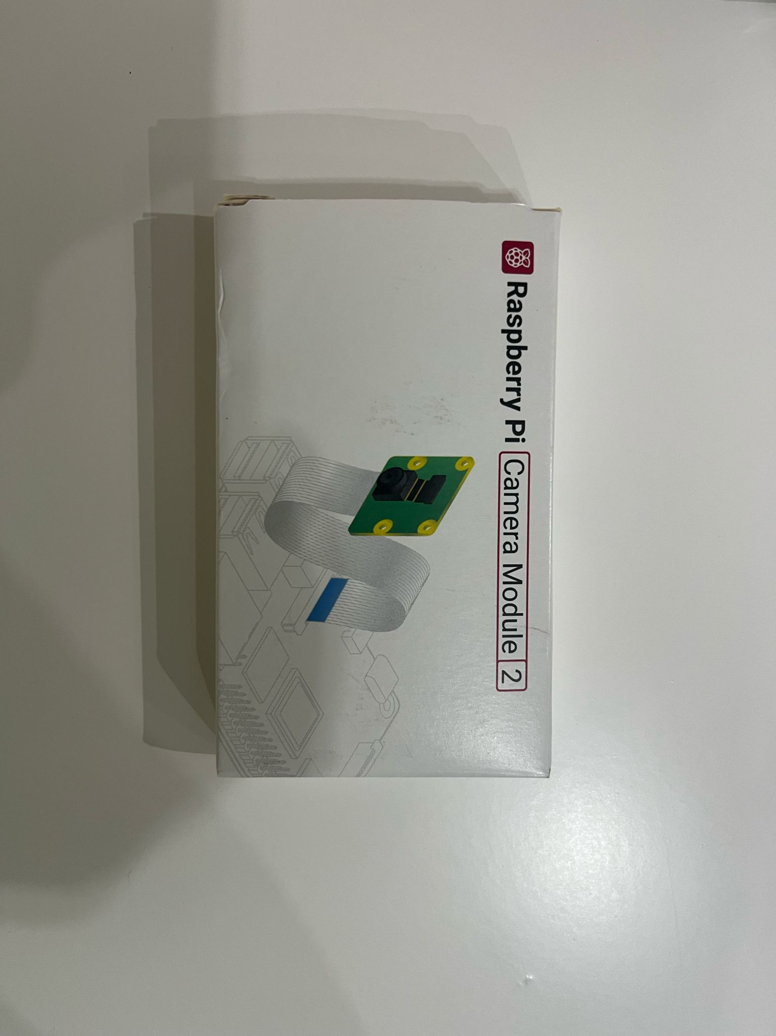
■ 6. Hardware Assembly and OS Configuration
Degree IN Informatics engineering
Components Overview
Raspberry Pi 5 (8GB RAM)
Raspberry Pi Camera Module 2
The heart of the project. A high-performance minicomputer used to run the operating system and control the peripherals.
Official camera module used to capture images or video, ideal for computer vision projects.
@Diogo Azevedo, Letícia Loureiro| Course: Projeto IV – Academic Year 2024/2025 – Lightweight Authentication System with Facial Recognition
- 31 -

Slide 32
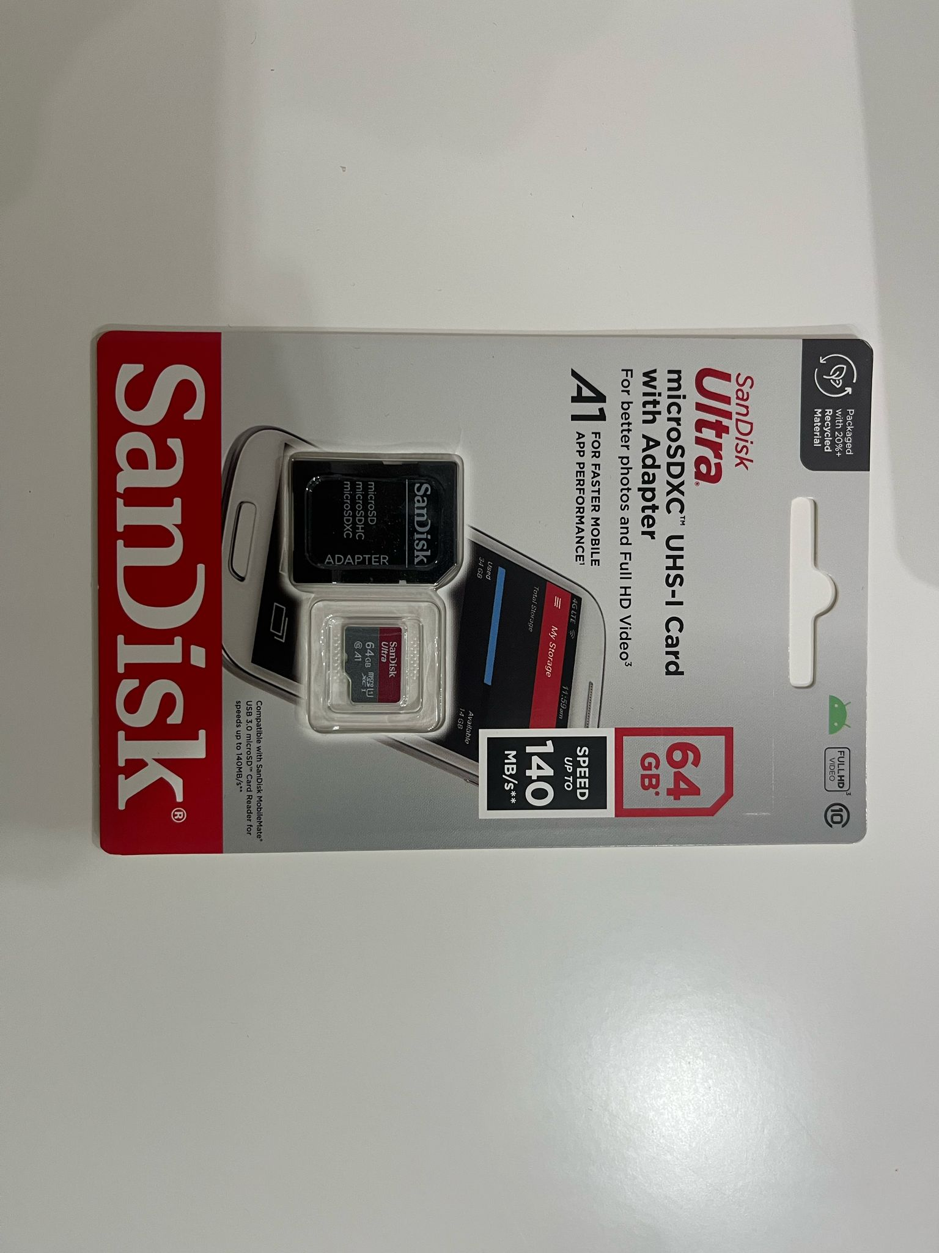
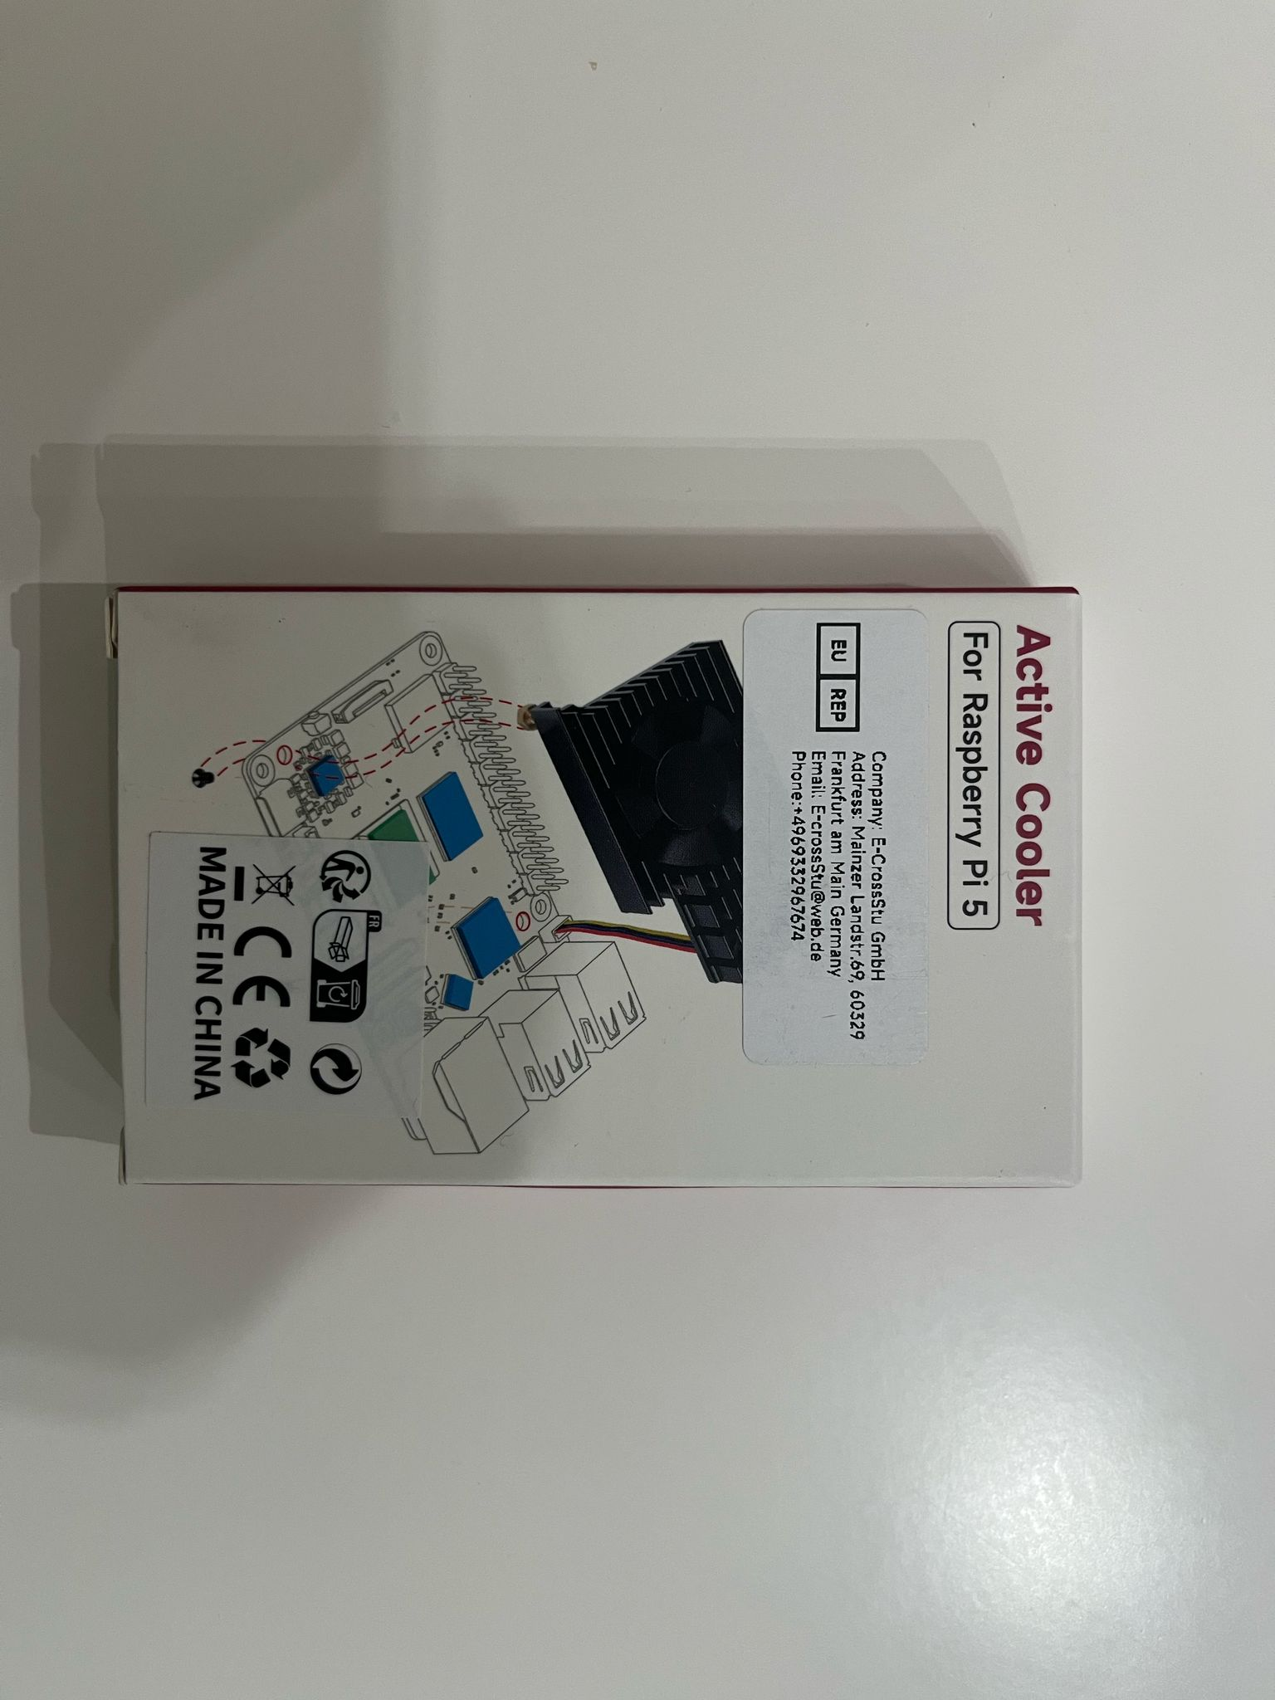
■ 6. Hardware Assembly and OS Configuration
Degree IN Informatics engineering
Components Overview
SanDisk 64GB microSD Card
Active Cooler (Heatsink with Fan)
Main storage where the Raspberry Pi OS and necessary drivers were installed. High-speed performance ensures smooth operation.
Essential cooling system to keep the Raspberry Pi at optimal temperatures during intensive use.
@Diogo Azevedo, Letícia Loureiro| Course: Projeto IV – Academic Year 2024/2025 – Lightweight Authentication System with Facial Recognition
- 32 -

Slide 33
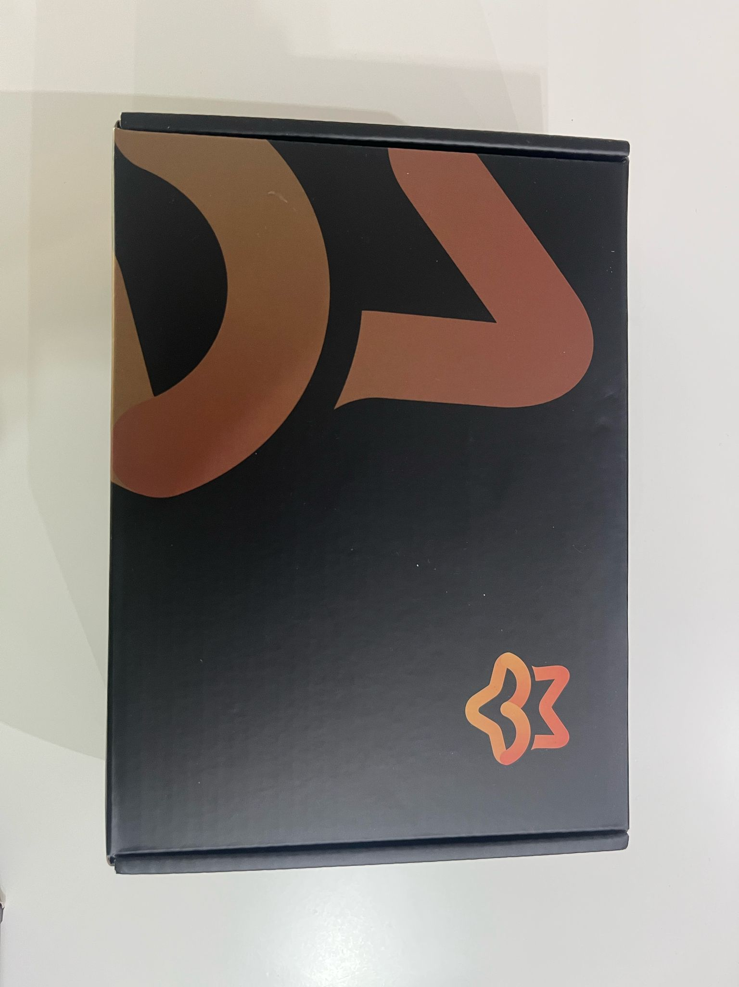
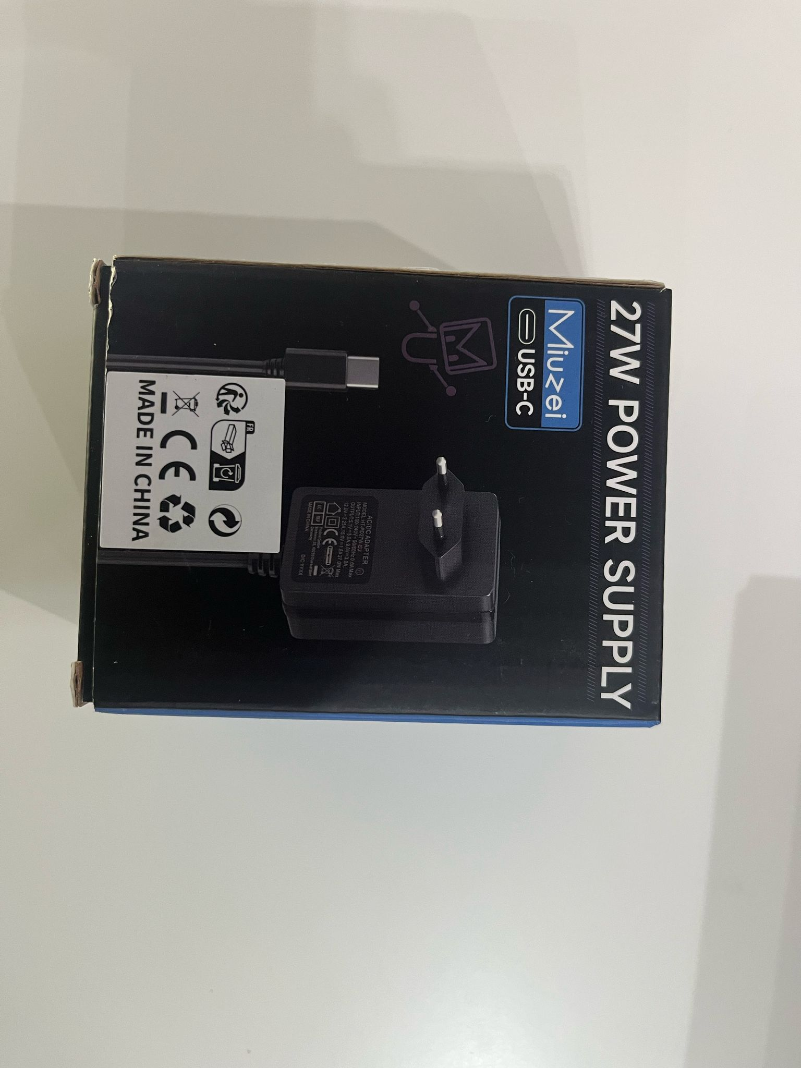
■ 6. Hardware Assembly and OS Configuration
Degree IN Informatics engineering
Components Overview
27W Power Supply (USB-C)
7” Touchscreen Display (Luckfox)
Provides sufficient power to support the Raspberry Pi 5 and all peripherals, ensuring system stability.
Display with 1024x600 resolution and touch support. Enables direct interaction with the system without the need for a mouse or keyboard.
@Diogo Azevedo, Letícia Loureiro| Course: Projeto IV – Academic Year 2024/2025 – Lightweight Authentication System with Facial Recognition
- 33 -

Slide 34
■ 6. Hardware Assembly and OS Configuration
Degree IN Informatics engineering
System Assembly and Software Installation
At this stage, all physical components of the project were assembled, including:
Raspberry Pi 5 with an active cooler (fan) to ensure efficient cooling.
7” touchscreen display (1024x600 at 60Hz), directly connected to the Raspberry Pi.
Official Raspberry Pi camera, connected via flat cable (CSI interface).
Support structure to keep the setup stable and functional.
After the assembly, the Raspberry Pi OS (official operating system) was installed, along with the necessary drivers to ensure the proper functioning of both the display and the camera. The graphical interface was successfully validated, as shown in the image.
@Diogo Azevedo, Letícia Loureiro| Course: Projeto IV – Academic Year 2024/2025 – Lightweight Authentication System with Facial Recognition
- 34 -

Slide 35
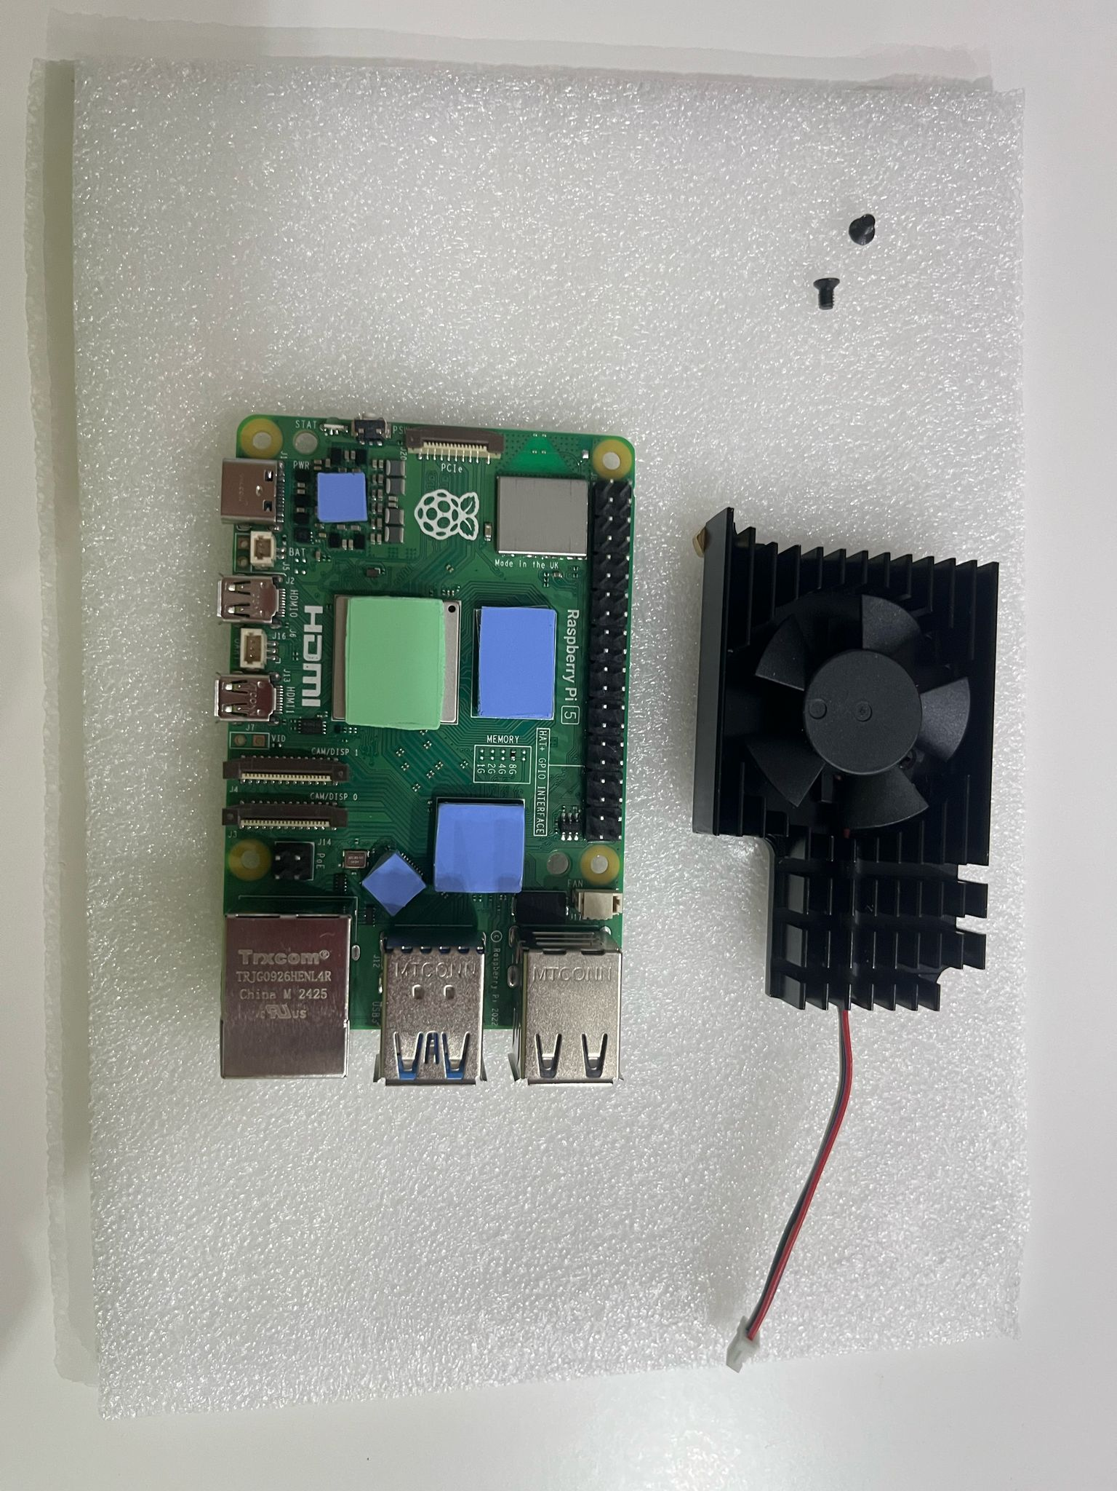
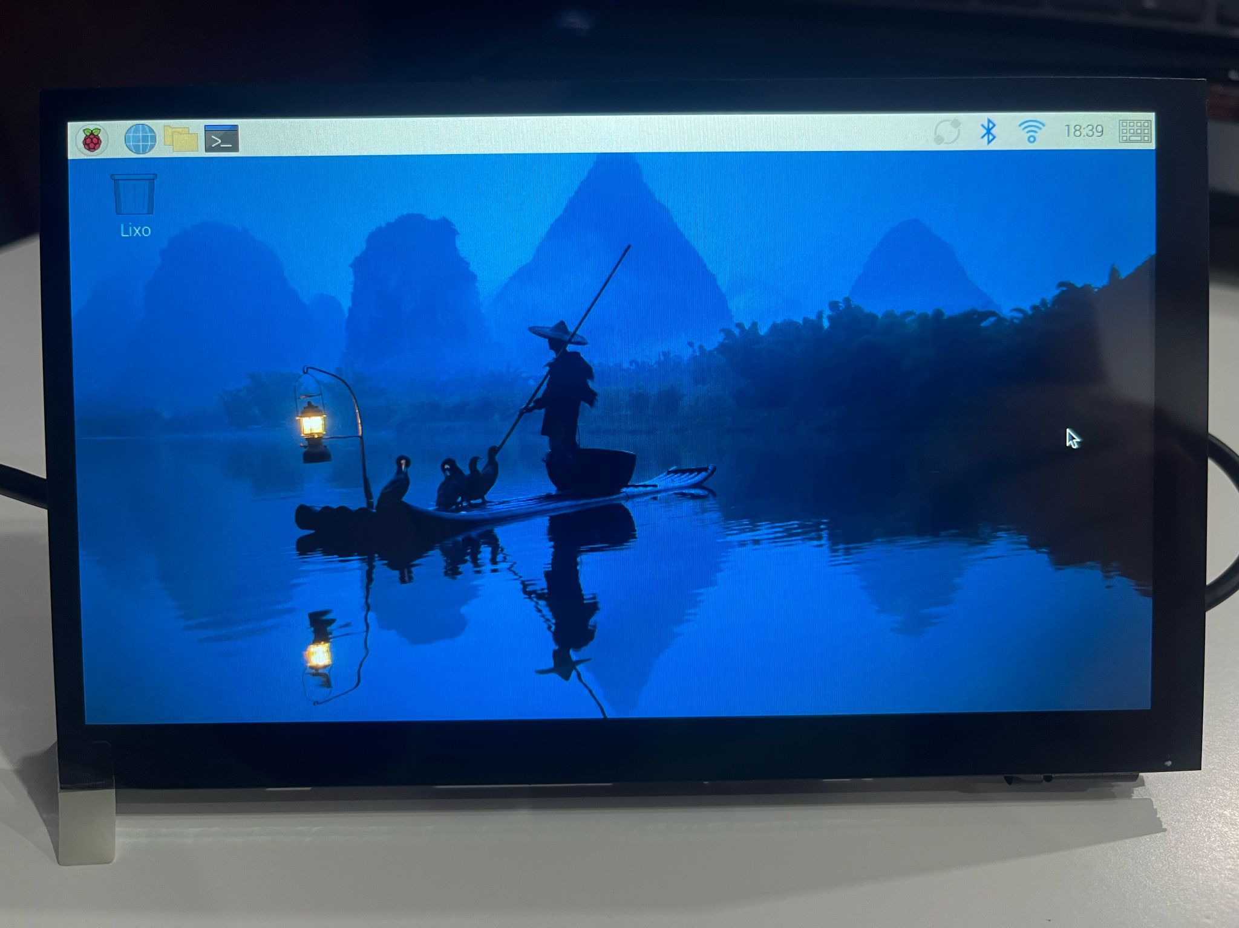
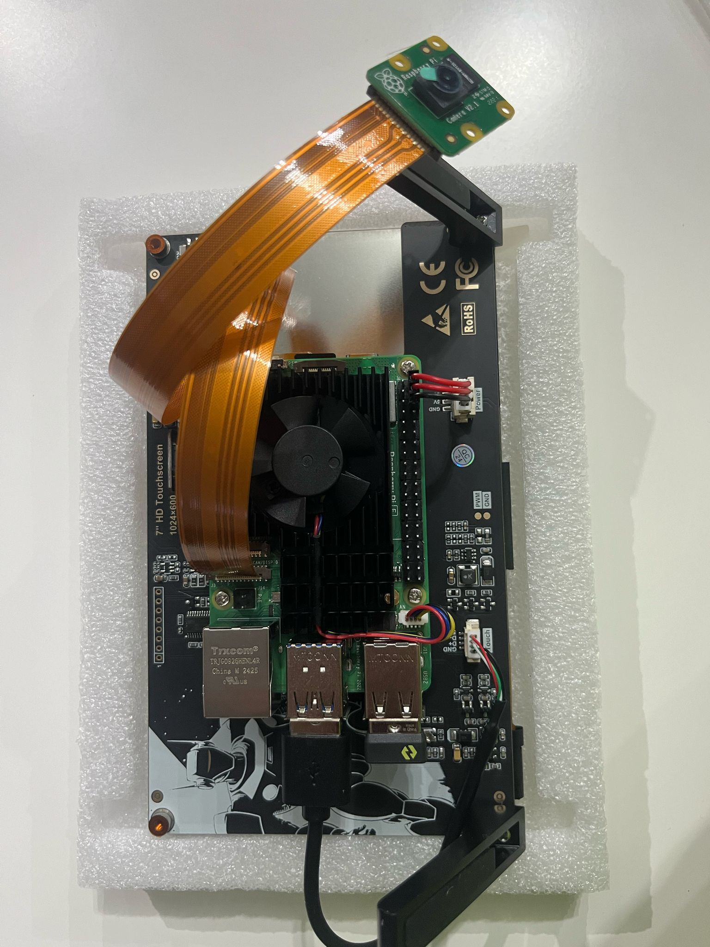
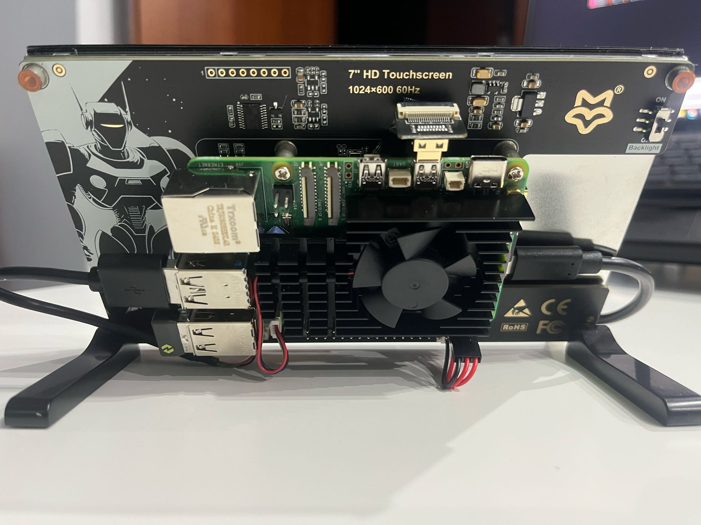
■ 6. Hardware Assembly and OS Configuration
Degree IN Informatics engineering
System Assembly and Software Installation
@Diogo Azevedo, Letícia Loureiro| Course: Projeto IV – Academic Year 2024/2025 – Lightweight Authentication System with Facial Recognition
- 35 -

Slide 36
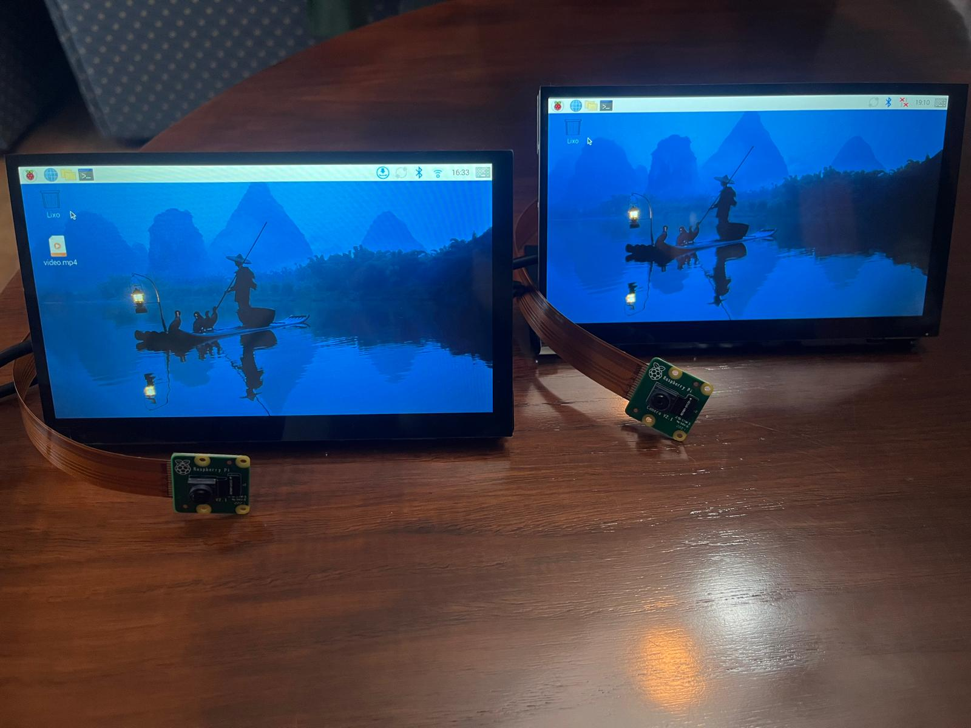
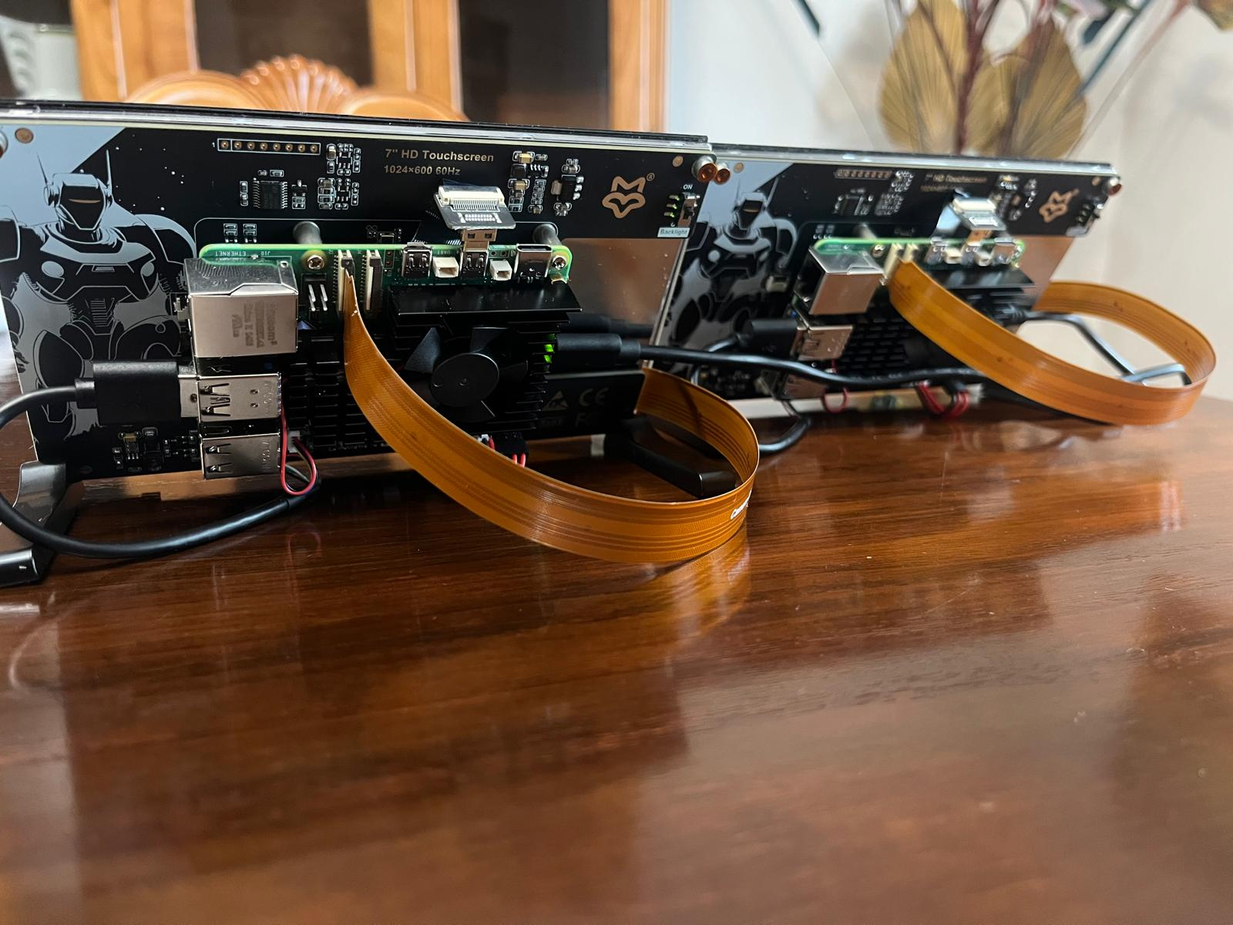
■ 6. Hardware Assembly and OS Configuration
Degree IN Informatics engineering
System Assembly and Software Installation
@Diogo Azevedo, Letícia Loureiro| Course: Projeto IV – Academic Year 2024/2025 – Lightweight Authentication System with Facial Recognition
- 36 -

Slide 37
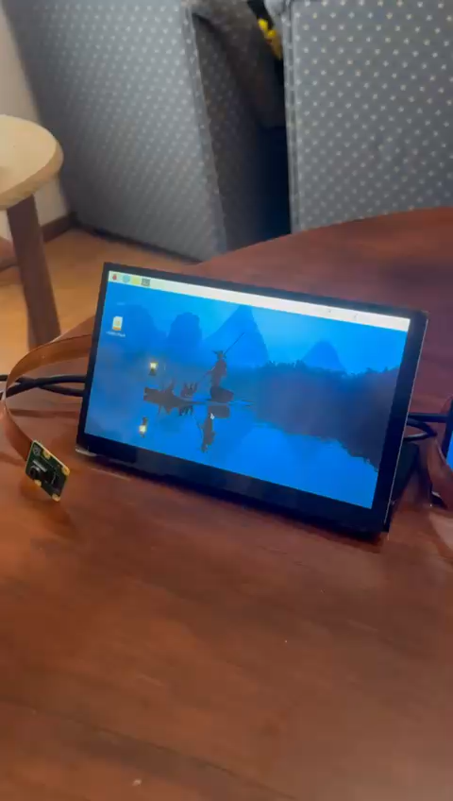
■ 6. Hardware Assembly and OS Configuration
Degree IN Informatics engineering
Demonstration Video – System in Operation
This video showcases the assembled system in operation, with the touchscreen fully functional on both Raspberry Pi devices used in the project both assembled by us from scratch, starting with individually delivered components.
In addition to the touchscreen responsiveness, the Raspberry Pi OS graphical interface is visible, properly installed and configured.
The official Raspberry Pi camera module is also correctly connected and positioned, ready to capture images required for the facial recognition process.
@Diogo Azevedo, Letícia Loureiro| Course: Projeto IV – Academic Year 2024/2025 – Lightweight Authentication System with Facial Recognition
- 37 -

Slide 38
■ 7. Database Architecture Overview - FaceAuth System
Degree IN Informatics engineering
The FaceAuth platform relies on a well-structured relational database composed of four core tables, each designed to support a specific aspect of the system’s functionality:
users
Stores the essential information of each user. This is the central table from which relationships with all other data are established.
user_face_data
Contains the processed facial data of users, enabling the system to perform accurate and secure face recognition.
access_logs
Keeps a detailed log of all system access attempts, indicating whether the user was recognized, along with date and time.
integrations
Handles external service configurations linked to users, such as notifications or API connections with other platforms.
@Diogo Azevedo, Letícia Loureiro| Course: Projeto IV – Academic Year 2024/2025 – Lightweight Authentication System with Facial Recognition
- 38 -

Slide 39
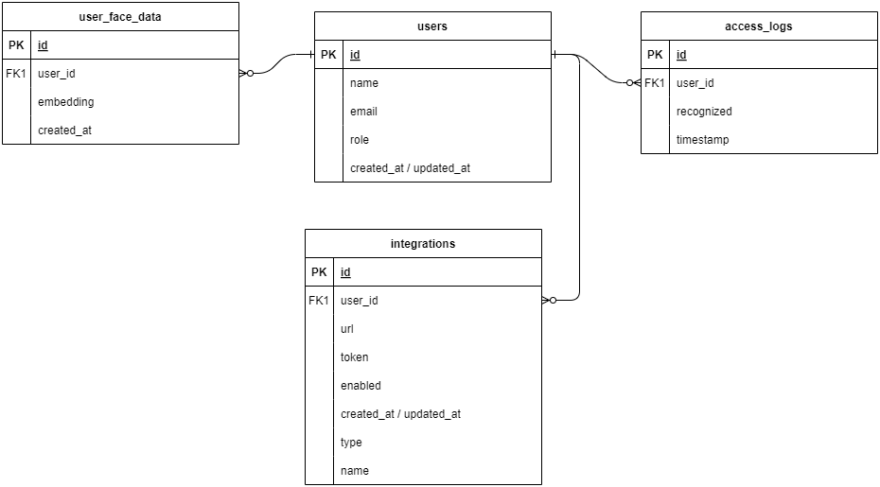
■ 7. Database Architecture Overview - FaceAuth System
Degree IN Informatics engineering
@Diogo Azevedo, Letícia Loureiro| Course: Projeto IV – Academic Year 2024/2025 – Lightweight Authentication System with Facial Recognition
- 39 -

Slide 40
■ 8. FaceAuth - System Architecture Overview
Degree IN Informatics engineering
The system architecture defines the entire face recognition flow, from image capture to authentication and user feedback:
The camera captures the image and sends it to the Raspberry Pi.
The Raspberry Pi processes the image using TensorFlow/OpenCV to extract face data.
It sends the data to a REST API for comparison with the database.
The API returns whether the face was recognized or not.
The result is shown on the touchscreen: "Access Granted" or "Denied".
A log entry is created (success or failure).
Optionally, a notification is sent via Discord, Zapier, etc.
@Diogo Azevedo, Letícia Loureiro| Course: Projeto IV – Academic Year 2024/2025 – Lightweight Authentication System with Facial Recognition
- 40 -

Slide 41
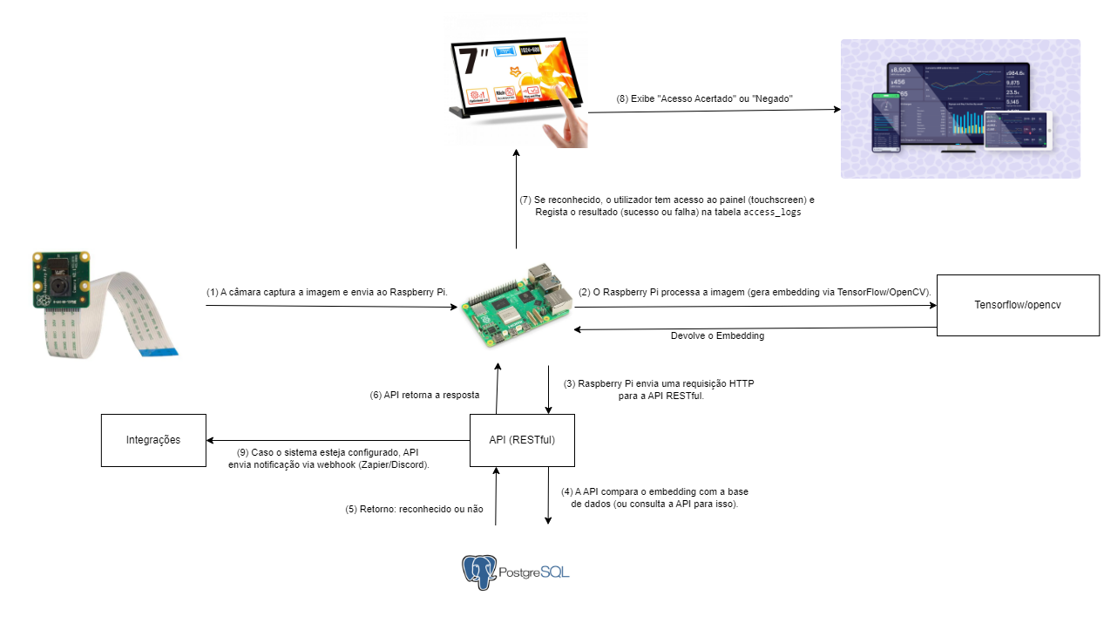
■ 8. FaceAuth - System Architecture Overview
Degree IN Informatics engineering
@Diogo Azevedo, Letícia Loureiro| Course: Projeto IV – Academic Year 2024/2025 – Lightweight Authentication System with Facial Recognition
- 41 -

Slide 42
■ 9. Conclusion
Degree IN Informatics engineering
Planning:
The schedule was defined with well-organized stages, from group formation to final delivery.
Clear Objectives and Deliverables:
Each week had specific goals and concrete deliverables, making it easier to track progress.
Integration of Key Modules:
The project ensured the integration of facial recognition, touchscreen interface, dashboard, and RESTful API.
Extra Features:
Additional features such as sound feedback.
Active Risk Management:
Technical and operational risks were identified, with mitigation strategies defined for each.
Schedule Flexibility:
The planning allows for adjustments based on feedback and testing throughout development.
@Diogo Azevedo, Letícia Loureiro| Course: Projeto IV – Academic Year 2024/2025 – Lightweight Authentication System with Facial Recognition
- 42 -

Slide 43
■ 9. Conclusion
Degree IN Informatics engineering
Application of Technical Concepts:
Artificial intelligence, hardware integration, and cybersecurity concepts were applied in practice.
Final Outcome:
The project will result in a robust, functional, well-documented system aligned with the initial objectives.
@Diogo Azevedo, Letícia Loureiro| Course: Projeto IV – Academic Year 2024/2025 – Lightweight Authentication System with Facial Recognition
- 43 -

Slide 44
■ 10. Web References
Degree IN Informatics engineering
Raspberry Pi (s.d.). Getting Started – Official Documentation. Accessed on March 8, 2025, from: https://www.raspberrypi.com/documentation/computers/getting-started.html
Installing Raspberry Pi OS (n.d.). [Vídeo]. YouTube. Accessed on March 8, 2025, from: https://www.youtube.com/watch?v=ZH6vfvRstfM
Initial Setup of Raspberry Pi (n.d.). [Vídeo]. YouTube. Accessed on March 8, 2025, from: https://www.youtube.com/watch?v=sq5S1MM2Pmo
TensorFlow Lite – Facial Recognition (n.d.). [Vídeo]. YouTube. Accessed on March 8, 2025, from: https://www.youtube.com/watch?v=aimSGOAUI8Y
@Diogo Azevedo, Letícia Loureiro| Course: Projeto IV – Academic Year 2024/2025 – Lightweight Authentication System with Facial Recognition
- 44 -
Notes:
Tiago (acabar referencias)

Slide 45
■ 10. Web References
Degree IN Informatics engineering
OpenCV Face Recognition (n.d.). [Vídeo]. YouTube. Accessed on March 8, 2025, from: https://www.youtube.com/watch?v=3TUlJrRJUeM
Connecting Official Camera to Raspberry Pi 5 (n.d.). [Vídeo]. YouTube. Accessed on March 8, 2025, from: https://www.youtube.com/watch?v=VeWBYRpodnI
Connecting HDMI Display to Raspberry Pi 5 (n.d.). [Vídeo]. YouTube. Accessed on March 8, 2025, from: https://www.youtube.com/watch?v=QhdRg2x6vxo&t=2s
@Diogo Azevedo, Letícia Loureiro| Course: Projeto IV – Academic Year 2024/2025 – Lightweight Authentication System with Facial Recognition
- 45 -
Notes:
Tiago (acabar referencias)

Slide 46
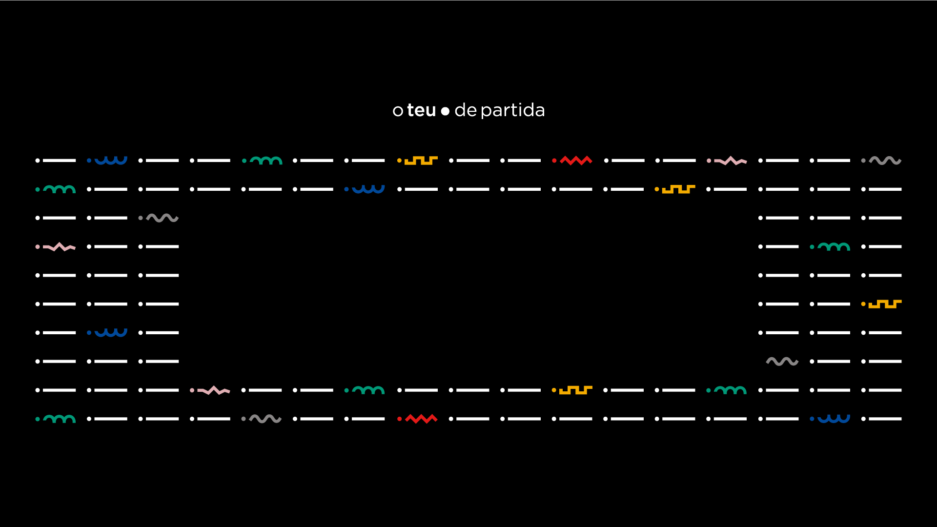
www.ipvc.pt

